Slide 1




Automated Workflow Development
Employee Leave Requests Approval Workflow

Slide 2
Table of Contents
Introduction
Key Process Flow
Automated Workflow
Key Features
Impact of the Automation
Improvements to the Automated Flow
Conclusion
Q & A
2

Slide 3
Introduction
Scenario :-
Automating Leave Requests Approvals in an Organization Using Power Automate
Objective :-
Automate the process of submitting and notifying an employee about the leave request.
Ensure timely communication between employees, managers and the Human Resource unit.
Make the work of many employees easier and faster.
3

Slide 4
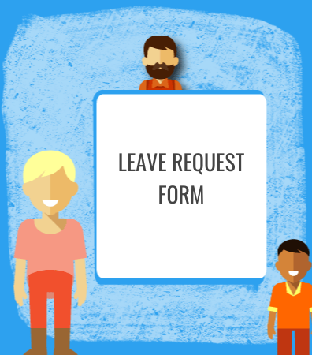



Key Process Flow
Submission of Leave Requests
Data Handling
Manager Approval
Notifications to Stakeholders

Slide 5
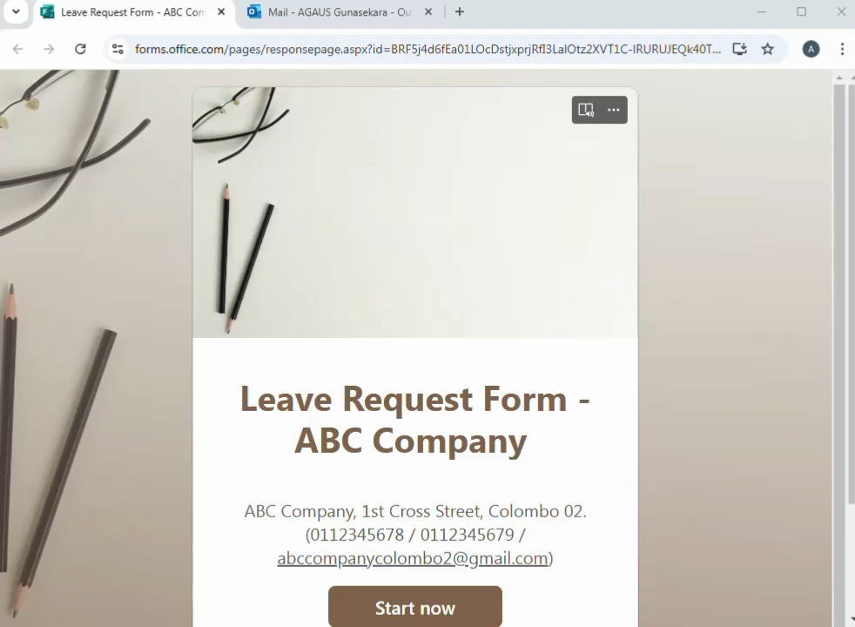
Automated Workflow
5

Slide 6
Key Features
Actions : -
Get Response Details : Retrieve submitted form data.
Save to SharePoint to store data for tracking.
Start and Wait for an Approval: Request the approval and notify the manager.
Conditional Logic: Approve or reject the notes - checking the approval outcome should tell if the approval was Approved or Rejected.
Send Notifications: Inform the employees.
Trigger : -
The process begins with a leave request form that has being filled with an employee.
6

Slide 7




Key Features – Tools Used
Microsoft Forms Power Automate
SharePoint Outlook
7

Slide 8
Impact of the Automation
Time Savings
Improved Accuracy
Centralized Records
Enhanced Communication
8

Slide 9
Improvements to the Automated Flow
Calendar Sync: Connect with corporate calendars (e.g., Outlook, Google Calendar) to automatically mark approved leave days.
Customizable Approvals: Add flexibility for multi-level approvals based on leave type, duration, or employee hierarchy.
Status Notifications: Implement real-time notifications for approvals, rejections, or updates to streamline communication.
Leave Trends Analysis: Generate detailed reports on leave patterns to help management with workforce planning.
9

Slide 10
Conclusion
An automated leave request system improves organizational efficiency by ensuring timely processing, reducing delays, and eliminating errors from manual work.
It enhances communication, fosters better workforce planning, ensures policy compliance, and creates a positive work environment.
Therefore, organizations must try to organize their leave records well and attempt to enhance the operating system and subsequently; a better work environment should be fostered.
10

Slide 11



Q & A
11

Slide 12

Thank You
BSc in Applied Data Science Communication
Intake 40
Advanced SQL & Cloud Databases
( LB 2224 )

